Slide 1
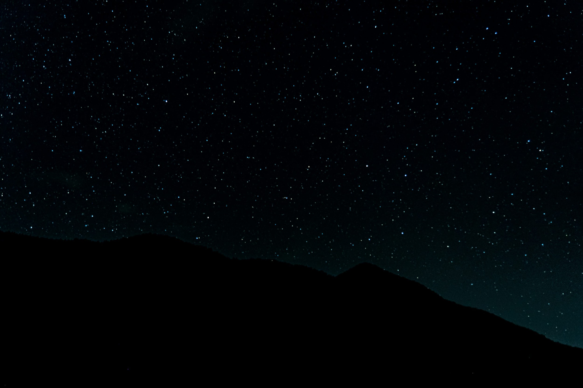
CubeSAT Conquest
Team members:
Sameer Chakrawarti
Himaja Desale
Shreyansh Yadav

Slide 2
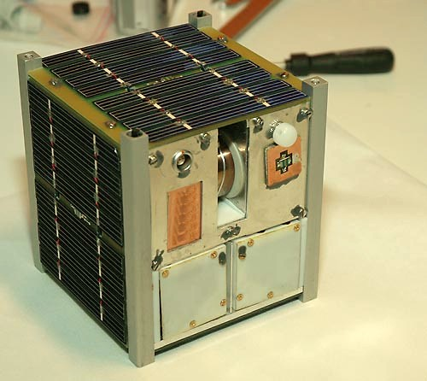
An Overview Of the CubeSat
Dimensions of the CubeSat: 15cm x 15cm x 15cm
Weight: Less than or equal to 1 kg
Objective: Main objective is to study
the atmosphere of Venus, also focus
on how your CubeSat will collect
data, transmit the data back to earth
and maintain its orbit.

Slide 3
Satellite Constraints
Polar Orbit Design
Weight Constraints
The satellite is designed for orbiting a polar orbit around the planet such that it doesn’t go into the shadow regions for long periods of time, since the longer it is in the shadow regions, the satellite will be working on its battery in this region which will drain the battery life hence reducing the life expectancy of our satellite.
Keeping the satellite under 1kg is challenging because studying Venus’s atmosphere requires three types of cameras:
High-Resolution Camera: for detailed images of the atmosphere and surface.
Infrared Camera: to analyze wind patterns and gas composition.
Ultraviolet Camera: to study atmospheric chemistry and predict possible events.

Slide 4
Designing Conditions
Thermal Management
Radiation Protection
Atmospheric Resistance
The satellite will be orbiting Venus near its exosphere, which implies that there would be temperature variations in the range of 180K to 320k. Since there is a temperature variation of around 140K, we will need proper thermal management.
There will be presence of high amount of solar radiation against the satellite for which we will be using a heat shield in order to protect the electronics used within the satellite.
Venus has a thick atmosphere comprising of CO2, SO2, N2 and water vapor, this makes its atmosphere acidic in nature which could also potentially affect our satellite.
Pressure and Wind Durability
Overall Endurance
The pressure on Venus is 92 times that of Earth and the winds in the upper atmosphere can reach up to very high speeds for this reason we require sensors that can minimize the impact from these winds.
The CubeSat must be able to withstand all of the above-mentioned issues, temperature/thermal management, good quality and long life sensors, immunity to the acidic nature present in the atmosphere.

Slide 5
Materials
Solar panels: Deployable solar panels on all the sides of the CubeSat except the top and bottom.
Battery: We make the use of a Li-CF_{x} battery which will not be rechargeable but can store up to long periods of time and can bare high temperatures. 200W/Hr.
Power management system: Used to regulate power to the various components of the satellite.
Sun Sensors: Used for course attitude determination.
Gas composition sensors((spectrometer): Used to analyse the composition of the gases present In the atmosphere of the planet.
Temperature and pressure sensors: Used to measure the temperature of the atmosphere and the pressure of the atmosphere of the planet
Radiation sensors: These are used understand the atmospheric environment by letting us know the radiation levels in the atmosphere.
Transceiver: A low-power transceiver for data transmission.

Slide 6
Materials
Antennas: 2 command receive antennas and 2 transmit antennas for optimal signal strength and one telemetry antenna.
Data storage: Flash memory for storing the collected data temporarily until it is transmitted to the relay Satellite.
Thrusters: These will be used for orbit management and to make any desired adjustments.
Attitude control: For this we use reaction wheels and magnetorquers to control the orientation of the satellite.
Data collection: This will be done by the sensors and the three different cameras which are the high-resolution camera – for images of the atmosphere and surface, infrared camera – to analyse the winds and composition of gases in the atmosphere and an ultraviolet camera – to study the atmospheric chemistry and to predict atmospheric phenomenon.
Radiator: We make use of a radiator in order to radiate away the heat developed by the components of the satellite or the heat absorbed by the satellite due the to sun.
Heat shield: This will be used to protect the block of electronic to ensure it does not get damage by the heat radiations. The heat shield will be made of aluminium and coated with a highly reflective material.
Carbon fibre: We will use this material to make the body of our satellite as its lightweight.

Slide 7
Design
Design
Block of electronics in the center of the satellite that would contain the OBC, Data storage, battery, power management system etc. This would be protected by a heat shield.
Around this block we put the magnetorquers and the reaction wheels that do the job of maintaining the attitude, both of these are kept on the base surface to which the block of electronics is attached.
Below that surface we attach the four thrusters and the sun sensors which will be used for the course attitude determination.
On top of the block of electronics we add the compartment that carries the payloads, our payload will compromise of all the sensors and the three different cameras. The payload will have a flap cover allowing it to be openable.
Above this compartment we put the face of the satellite which will be pointing towards the earth, the face contains 2 command receive antennas (at opposite corners) and 2 transmit antennas (at opposite corners) and one telemetry antenna which is used to transmit to the ground station the state of health of the satellite such as its temperature, battery percentage etc.
On the body of the satellite we install a radiator that will be used for cooling the satellite.
Finally we covers all the other sides except the top and bottom of the CubeSat with solar panels that will have a flap in order to be openable.

Slide 8
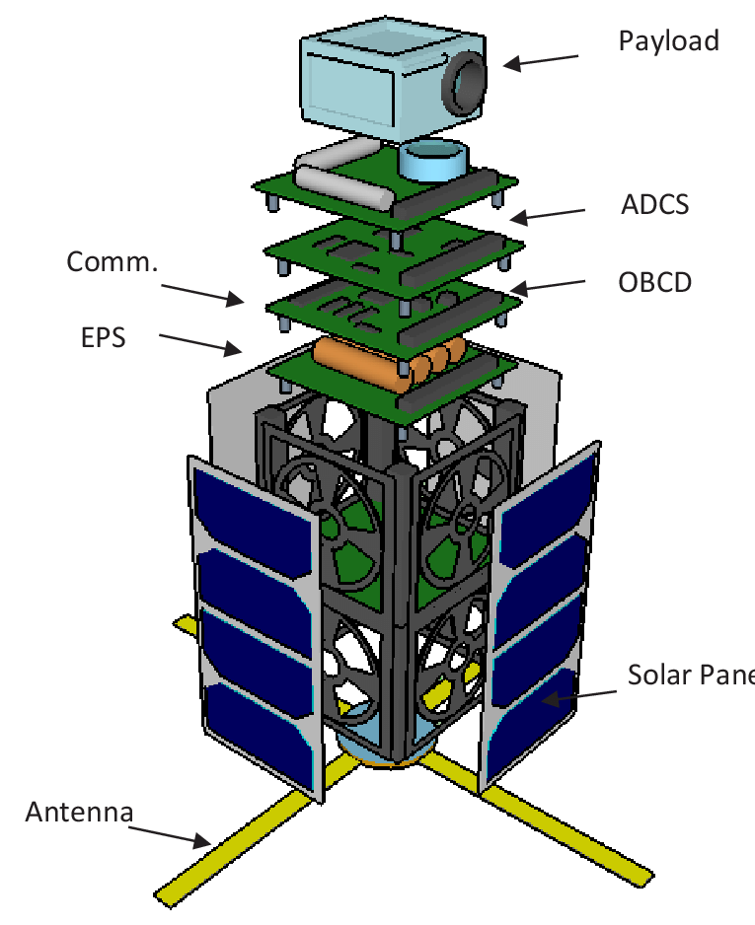
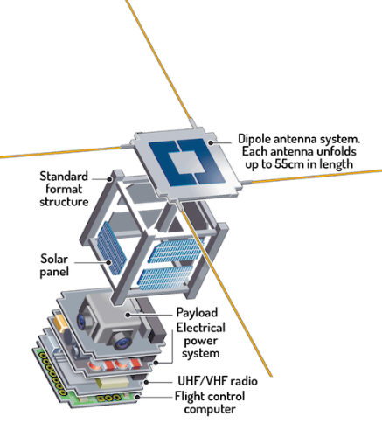

Slide 9
Data collection, Storage and Transmission
We make use of high-resolution visible light camera for images of the surface of the planet.
We use infrared camera to analyse the winds and air currents.
The ultraviolet camera Is used the study the atmospheric chemistry and predict any phenomenon that could occur the atmosphere of the planet.
We make use of thermal images captured by the infrared camera in order to analyse the winds in the atmosphere.
We use a spectrometer which is a gas composition sensor to find the composition of the different gases in the atmosphere
Temperature and pressure sensors are used to find the temperature and pressure of the atmosphere and a radiation sensor to figure out the radiation level in the atmosphere.
All off this collected data is temporarily stored for a short amount of time as flash memory in the our data storage device.
The data remains stored as flash memory until it is transmitted to the relay satellite after which flash memory is flushed to store new data.

Slide 10
Weight Calculations
Solar panels: Lightweight panels, approximately 150g.
Battery: Li-CF_{x} battery, approximately 100g.
Power Management system: Power regulator and the circuitry associated with it would be around 50g.
Sensors:- Gas composition sensor(spectrometer): 80g, Temperature sensor: 20g, Pressure sensor: 20g, Radiation sensor: 30g, Sun sensors:20g.
Cameras:- High resolution visible light camera: approximately 100g, infrared camera: approximately 100g and ultraviolet camera: approximately 100g
Communication equipment:- Transceiver: approximately 80g, Antennas: approximately 50g, Data storage: approximately 50g.
Orbit maintenance: Thrusters 4x: Around 80g, 20g each, attitude control: Reaction wheels and magnetorquers: approximately 90g.
Thermal/Heat management: Heat radiator and Heat Shield: approximately 100g
Body of the satellite made of carbon fibre(lightweight, 1.6gm/cm³): 2x(15x15x0.25)cm panels = 112.5cm³, and 4x rods(15x0.5 diameter)cm =11.33cm³, weight = 198.12g
Total weight of the satellite = 1418.12grams = 1.42kg

Slide 11
Areas of Failure
The weight of the satellite is 1.52kg while 1kg was expected, this is due to requirement of adequate utilities in the payload such as the cameras and the sensors in order to make the maximum output from the satellite.
Requirement of a relay Communication satellite as our satellite has a very small data storage so it cannot store the data for very long hence fast transmission will be required for which we require a relay satellite in the higher orbit of earth (Close to Venus).

Slide 12
References
https://www.youtube.com/watch?v=oWidvY7JzFE&ab_channel=TheRoyalInstitution
https://www.aero.iitb.ac.in/satelliteWiki/index.php/Main_Page
https://www.nasa.gov/wp-content/uploads/2017/03/nasa_csli_cubesat_101_508.pdf
https://www.nasa.gov/smallsat-institute/sst-soa/structures-materials-and-mechanisms/#6.2.2
https://www.cubesat.org
https://www.aac-clyde.space/what-we-do/space-products-components
https://anywaves.com/resources/blog/what-is-a-satellite/

